Slide 1
Parallel Sets

Slide 2
What are Parallel Sets ?
Parallel Sets(ParSets) is a visualization application for categorical data that shows data frequencies instead of the individual data points.
This method is based on the axis layout of parallel coordinates, with boxes representing the categories and parallelograms between the axes showing the relations between categories.
Parallel Sets allow the user to interactively remap the data to new categorizations, and thus to consider more data dimensions during exploration and analysis than usually possible.

Slide 3
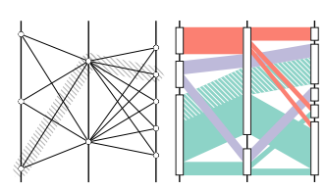
Differences :
Parallel Sets adopts the layout of parallel coordinates, but substitutes the individual data points by a frequency-based representation.
Parallel Sets combine the flexible layout of parallel coordinates i.e., treating all displayed dimensions visually independent from each other

Slide 4
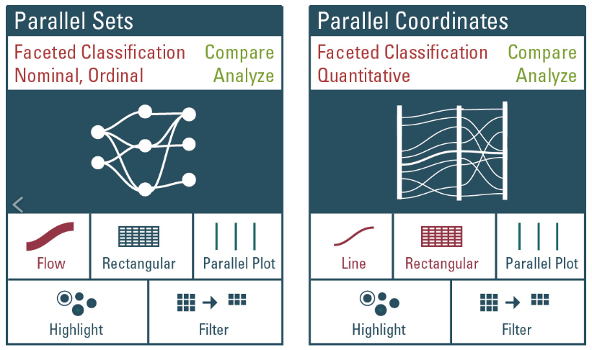
Comparison :

Slide 5
Visual Metaphor :
The visual metaphor serves as a natural way of mapping categorical variables to visual entities, which makes effective interactive exploration and analysis possible.
The basic building block of Parallel Sets is:
Box that represents the size of a category on one axis relative to all the data samples.
Parallelograms connect categories to show how many data points are in any of the combinations between two or more categories.
Color is used to differentiate the categories and to make the connections between them.

Slide 6
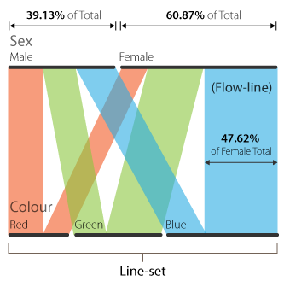
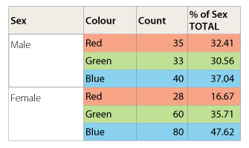
Example :

Slide 7
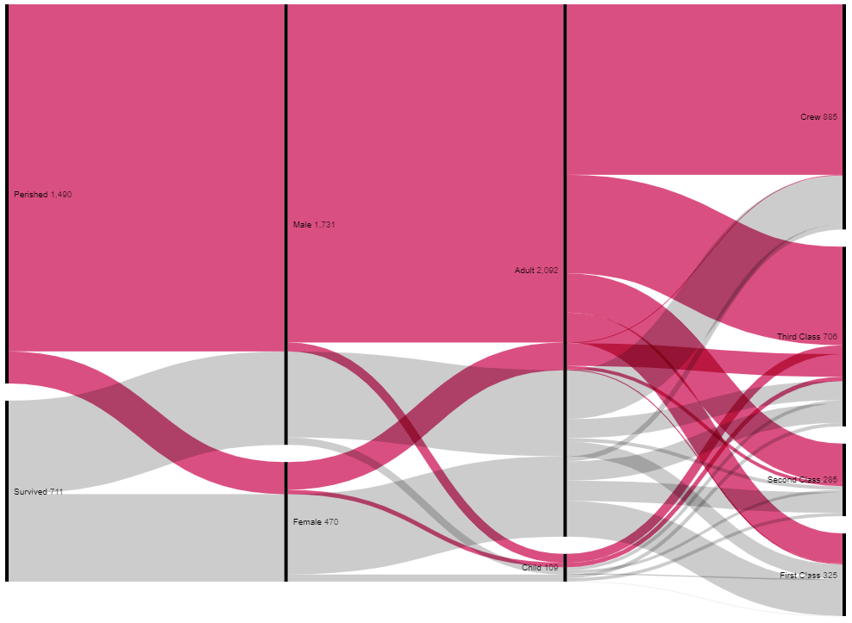
Titanic dataset :

Slide 8
Advantages :
The Parallel Sets technique combines the advantages of
Frequency-based techniques - Implementing a discrete design model and displaying the frequencies of categories.
Parallel coordinates - Treating dimensions independently.

Slide 9
Tools :
Parallel sets Application
D3
Python
R
Excel
Tableau

Slide 10
References :
https://www.jasondavies.com/parallel-sets/
https://observablehq.com/@d3/parallel-sets
http://bl.ocks.org/igorzilla/3086651
http://multivis.net/lecture/parallel-sets.htm
https://eagereyes.org/parallel-sets
https://rdrr.io/cran/ggforce/man/geom_parallel_sets.html
https://datavizcatalogue.com/methods/parallel_sets.html

Slide 11
THANK YOU !!

